Slide 1
Manalapan Township
Municipal Operating Budget
A Great Place To Live
Mayor Jack McNaboe
Deputy Mayor Susan Cohen
Committeewoman Mary Ann Musich
Committeeman Barry Jacobson
Committeeman Eric Nelson

Slide 2
Making ‘Cents’ of Your Dollars
Total School Share 66%

Slide 3
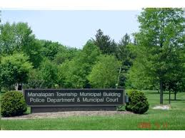
MANALAPAN TOWNSHIP
2021 MUNICIPAL BUDGET
The Township Committee
Continues to Provide
High Quality Municipal Services
to Manalapan Residents while
Minimizing the Financial Impact to the
Township Taxpayers During a Public Health Emergency

Slide 4
2021 Budget
PUBLIC HEALTH EMERGENCY CONTINUES
“Municipal Government remains the most efficient & effective form of government – delivering an extraordinary wide range of services directly to its residents.” LOM Magazine June 2020
Local Government is Essential
Manalapan Township continues to provide services, and access to services, stability and support
ALL Departments Operating
We are leading our community and staff through the crisis, recovery and re-opening process.

Slide 5
MANALAPAN TOWNSHIP
2021 Budget Goals
Minimize Current Year Tax Increase
While Maintaining Services Provided
(Weekly Garbage Collection, Bi-Monthly Recycling, Bulk Pick-Up, Brush Collection)
Manage Public Health Emergency
Meet State Guidelines on Spending Cap and Levy Cap
Achieve Fiscal Stability by Considering Both the
Short and Longer Term Financial Impact of this
Year’s Budget Decisions.

Slide 6
2021 Budget A Glimpse at Each Department
Health Department: Front line for Testing, Reporting Results & Contact with residents with Positive Cases; Contact Tracing
Police Department & Court: Public Safety & Justice System
Public Works: Sanitation, Recycling, Leaf Collection, Storm Damage and Preparedness, Roadways, Mowing & Maintenance, Buildings & Grounds Upkeep, Trees
Construction, Zoning/Code Enforcement: Permits, Applications, Residential & Commercial, Quality of Life, Safety Issues
Finance /Tax / Assessor: Budget, Grants, Tax Collections, Purchasing, Reassessment
Clerk: Processing Licenses, Elections, Information Requests, Resolutions & Ordinances
Recreation: Scheduling & Change in Programming, Safety of Rec Center, Alternates to Camp, Virtual
Senior Center: Checking in on Seniors, Vaccination Program, Virtual Programming, Preparing for return, Grants
Administration: Oversees it All

Slide 7
2021 BUDGET
Garbage & Recycling Collection Township Provided
Public Safety
Snow Removal
Capital Projects
----
State Aid Remains Flat
Local Revenue Losses
Appropriation Increases

Slide 8
2021 Municipal Budget
Manalapan Municipal Tax Rate for 2021 will be 35.1 cents per $100 of assessed valuation up from 33.4 cents in 2020.
This represents a annual increase of $78.31 on the average assessed home.

Slide 9
Projected Cost to the Average Manalapan Household All Municipal Services
2021 AVERAGE ASSESSED HOME = $460,612 | Annually | Monthly | Weekly | Daily
Total Increase to the Average Assessed Home | $78.31 | $6.53 | $1.51 | $0.21
Total Municipal Taxes on an Average Assessed Home | $1,616.75 | $134.73 | $31.09 | $4.43

Slide 10
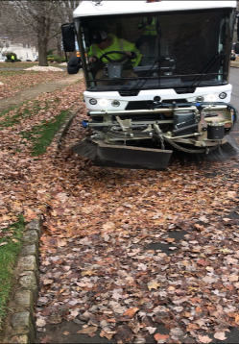
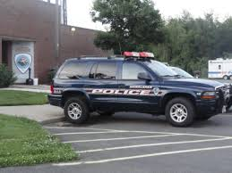
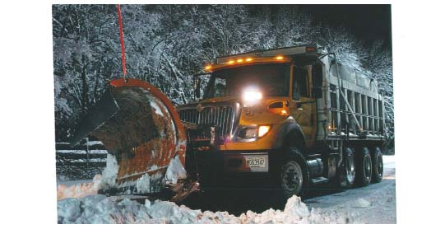
An Average Homeowner pays $134.73 a Month in Municipal Taxes for:
Public Works
Road repair
Salting & Snow Removal
Leaf Collection & Disposal
Park maintenance
Storm water mgmt. & detention basin maintenance
Buildings and grounds maintenance
Vehicle maintenance
Storm Branch and Brush Removal
Street Sweeping
Public Safety
24 hour police protection
School Safety
Emergency Management
Fire Prevention and Protection
First Aid - Contribution, Equipment
Municipal Court
Trash & Recycling Collection and Disposal
Weekly Garbage Collection
2X a month recycling collection
Branch and Brush Removal/Bulk Pick-Up
Code Building, Construction and Land Use Services
Enforcement; Planning and Zoning Boards
Safety Inspections and Proper Permitting

Slide 11
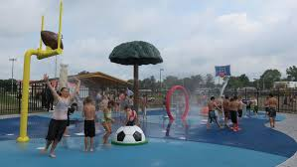
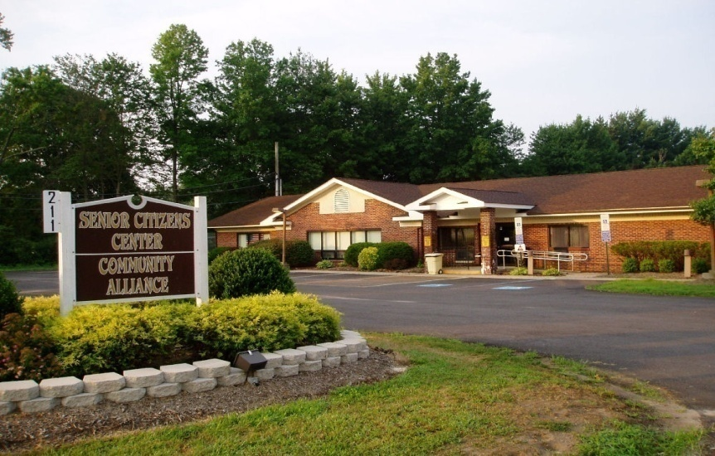
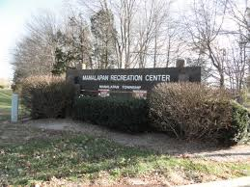
Residents continue to receive the following:
Recreational, Cultural and
Senior Citizen Programming
State of the Art Recreational Facility
Variety of Recreation Programs
Thompson Grove Park
Holiday Lake & Pocket Parks
Splash Park
Dog Park
Early Learning Programs
Summer Concert Series
Summer Camp
Virtual Classes
Holiday Events
Outdoor Bingo
Grab & Go Lunch
Vaccination Registration (Over 800)

Slide 12
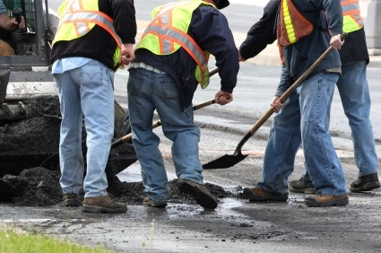
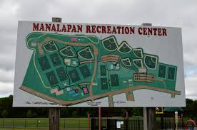
2021 Capital Projects
Road Repaving
Poets Annex Phase 2
Lambs Lane
Ryan Road (DOT Grant)
ADA Curb Compliance Program
Drainage Improvements
Road Resurfacing – Alexandria/Bucks Head/Elton Point Areas
Building and Grounds Projects &
Equipment Purchases
Loader & Hook Truck
Police Vehicles/Pick Up Trucks
Resurface Courts & Fitness Equip Rec Trail
Upgrade Volleyball, Hand Ball Courts
Various Playground Equipment
Computer Replacements

Slide 13
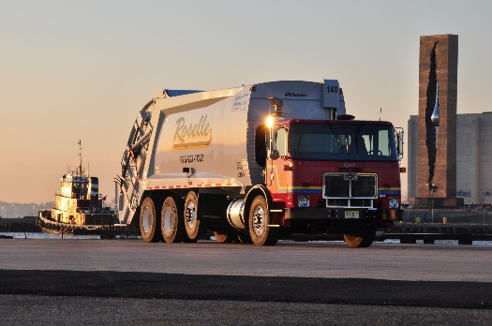
Trash & Recycling Collection and Disposal
Weekly Garbage Collection
Twice a month Recycling Collection
Branch and Brush Removal/Bulk Pick-Up
Street Sweeping
Towns in NJ required to provide Recycling Collection & Disposal
Not required to provide Trash Collection, Brush or Bulk Pick-Up
Neighboring Towns do not (Freehold, Marlboro, Old Bridge, Howell)
Estimated cost for private garbage $380
Collection Costs $2,212,500 …approx. $155 per household
Cost increased 33% over the past three years
Recycling Disposal Costs $2,015,000
47% increase in past 5 years

Slide 14
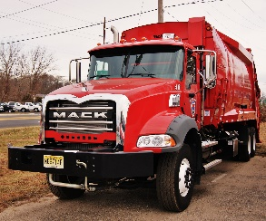
Tax Rate vs. Garbage Collection

Slide 15
Where Does It Go? $1,616.75
Public Safety: $387.65
Utilities, Sanitation & Recycling : $242.45
Insurances: $198.63
Statutory: $182.85
Public Works & Park Maintenance: $144.50
Capital Projects and Debt: $143.81
Reserve for Uncollected Taxes: $115.50
General Government: $ 82.96
Construction/Land Use: $ 44.67
Shared Services: $ 27.29
Parks & Recreation: $ 22.98
Health & Human Services: $ 16.72
Capital Improvement Fund: $ 5.65
Reserve for Tax Appeals: $ 1.10

Slide 16
2021 SOURCES OF REVENUE
FOR THE MUNICIPAL BUDGET
Revenue Source | Amount | % of Revenue
Amount to be Raised from Taxpayers | $25,179,133 | 68.09%
Surplus Utilization | $4,000,000 | 10.82%
State Aid | $3,868,653 | 10.46%
Local Revenues | $2,032,500 | 5.42%
Delinquent Taxes | $750,000 | 2.03%
UCC Construction Fees | $600,000 | 1.62%
Grants | $245,983 | 0.67%
Special Items - Fire Safety, Park Improvement | $200,000 | 0.54%
Interlocal Services | $134,277 | 0.36%
Total | $37,010,546 | 100.0%

Slide 17
HOW MUCH DOES EACH DEPARTMENT COST?
DEPARTMENT | 2021S&W | 2021 O.E. | 2021 TOTAL | % OF BUDGET
PUBLIC SAFETY | $8,462,950 | $343,795 | $8,806,745 | 23.81%
UTILITIES, SANITATION, LANDFILL & RECYCLING |  | $5,508,000 | $5,508,000 | 14.89%
INSURANCE | $ 96.250 | $4,416,313 | $4,512563 | 12.20%
STATUTORY EXPENSES |  | $4,153,969 | $4,153,969 | 11.23%
CAPITAL PROJECTS AND DEBT | - | $3,267,012 | $3,267,012 | 8.83%
PUBLIC WORKS & PARK MAINTENANCE | $2,155,200 | $1,127,500 | $3,282,700 | 8.88%
RESERVE FOR UNCOLLECTED TAXES | - | $2,629,058 | $2,629,058 | 7.11%
GENERAL GOVERNMENT | $1,276,046 | $608,590 | $1,884,636 | 5.10%
CONSTRUCTION DEPARTMENT/LAND USE | $925,750 | $88,960 | $1,014,710 | 2.74%
INTERLOCAL / SHARED SERVICE AGREEMENTS | $96,319 | $523,550 | $619,869 | 1.68%
PARKS & RECREATION | $429,750 | $92,345 | $522,095 | 1.41%
HEALTH & HUMAN SERVICES | $338,181 | $41,615 | $379,796 | 1.03%
STATE & FEDERAL GRANTS | - | $275,983 | $275,983 | 0.67%
CAPITAL IMPROVEMENT FUND |  | $128,411 | $128,411 | 0.35%
RESERVE FOR TAX APPEALS | - | $25,000 | $25,000 | 0.07%
TOTAL | $13,780,446 | $23,230,100 | $37,010,546 | 100.00%

Slide 18
ESTIMATED TAX RATE
In cents per $100 of Assessed Valuation
 | ESTIMATE 2021 | ACTUAL 2020
REGIONAL ELEMENTARY* | 0.949 | 0.945
REGIONAL HIGH SCHOOL* | 0.420 | 0.416
COUNTY* | 0.296 | 0.293
MUNICIPAL | 0.351 | 0.334
MUNICIPAL OPEN SPACE | 0.020 | 0.020
FIRE DISTRICTS (AVG.) | 0.048 | 0.048
TOTAL | 2.084 | 2.056

Slide 19
Making ‘Cents’ of Your Dollars
Total School Share 66%

Slide 20
Manalapan Township
A Great Place To Live
Public Hearing 2021 Budget – May 12, 2021
Mayor Jack McNaboe
Deputy Mayor Susan Cohen
Committeewoman Mary Ann Musich
Committeeman Barry Jacobson
Committeeman Eric Nelson

