Slide 1
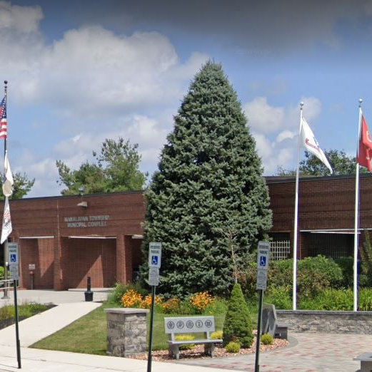
Town Hall Meeting
Wednesday, July 28
Join Mayor Jack McNaboe and Deputy Mayor Susan Cohen on Wednesday, July 28th for our next Town Hall Meeting.
7:00 pm to 8:00 pm in the Court Room of Town Hall, located at 120 Rt 522 in Manalapan.
You can speak to them about any topic that may be of interest to you.
No action will be taken at this meeting, it is for discussions only.

